Slide 1
4
INTEGRALS

Slide 2
4.4
The Fundamental Theorem of Calculus

Slide 3

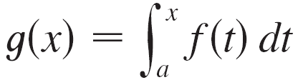
The Fundamental Theorem of Calculus
The Fundamental Theorem of Calculus gives the precise inverse relationship between the derivative and the integral.
The first part of the Fundamental Theorem deals with functions defined by an equation of the form
where f is a continuous function on [a, b] and x varies between a and b.

Slide 4
The Fundamental Theorem of Calculus
Observe that g depends only on x, which appears as the variable upper limit in the integral.
If x is a fixed number, then the integral is a definite number.
If we then let x vary, the number also varies and defines a function of x denoted by g(x).

Slide 5
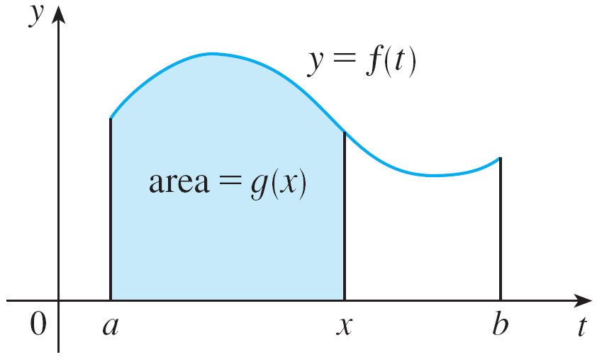
The Fundamental Theorem of Calculus
If f happens to be a positive function, then g(x ) can be interpreted as the area under the graph f of from a to x, where x can vary from a to b.
(Think of g as the “area so far” function; see Figure 1.)
Figure 1

Slide 6

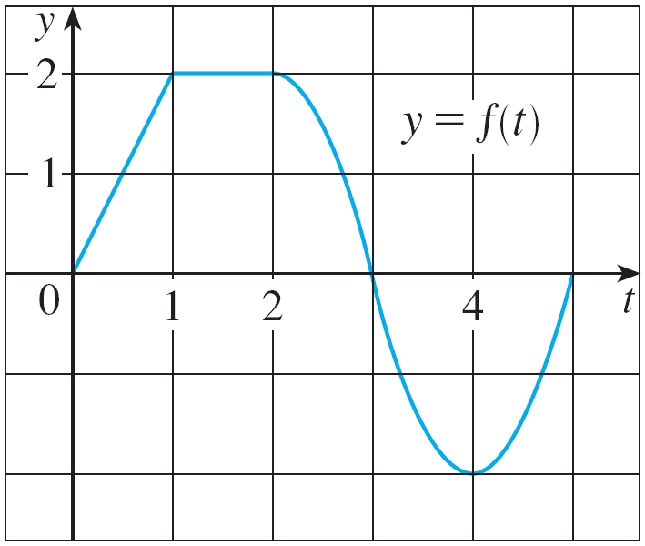
Example 1
If f is the function whose graph is shown in Figure 2 and
, find the values of g(0), g(1), g(2), g(3), g(4), and g(5).
Then sketch a rough graph of g.
Figure 2

Slide 7

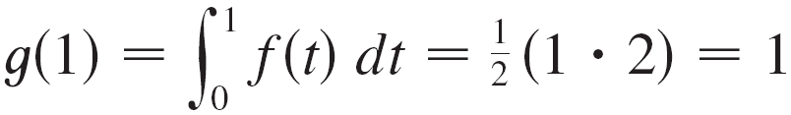
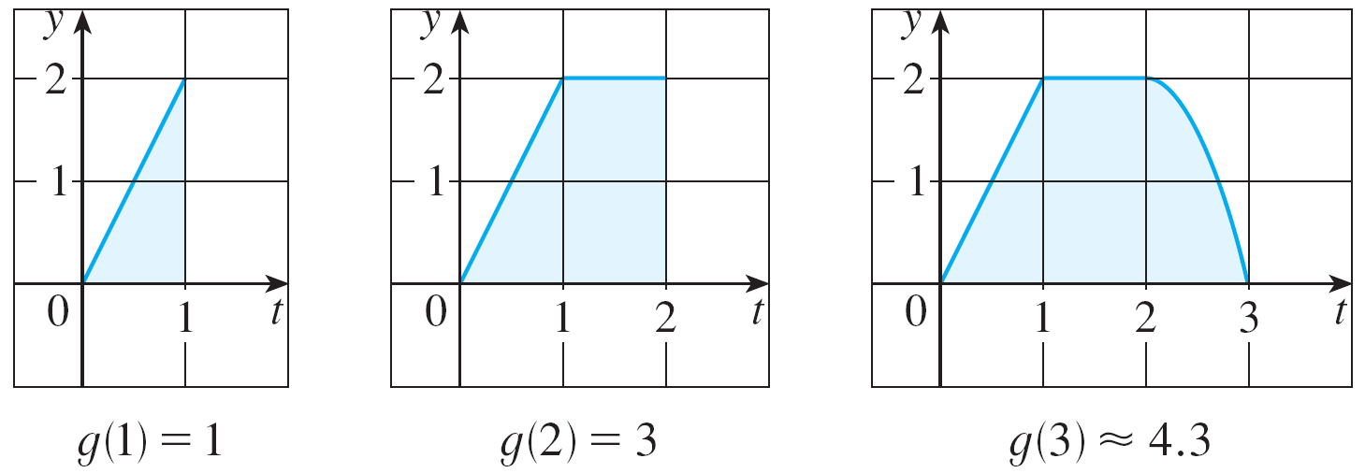
Example 1 – Solution
First we notice that
From Figure 3 we see that g(1) is the area of a triangle:
Figure 3

Slide 8
Example 1 – Solution
cont’d
To find g(2) we add to g(1) the area of a rectangle:
Figure 3

Slide 9
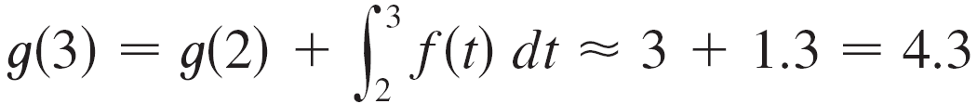
Example 1 – Solution
cont’d
We estimate that the area under f from 2 to 3 is about 1.3, so
Figure 3

Slide 10
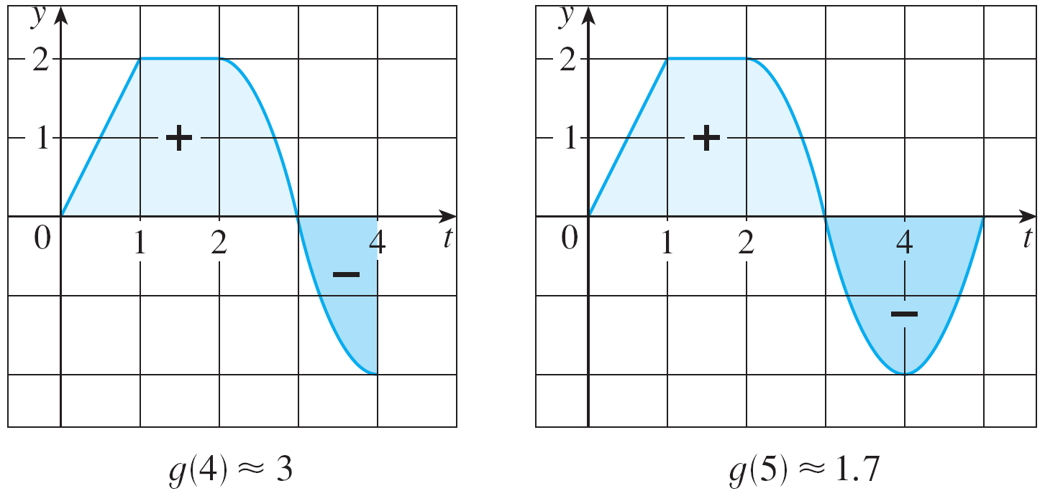
Example 1 – Solution
cont’d
For t > 3, f (t) is negative and so we start subtracting areas:
Figure 3

Slide 11
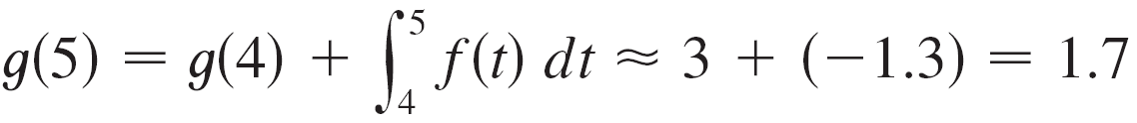
Example 1 – Solution
cont’d
Figure 3

Slide 12
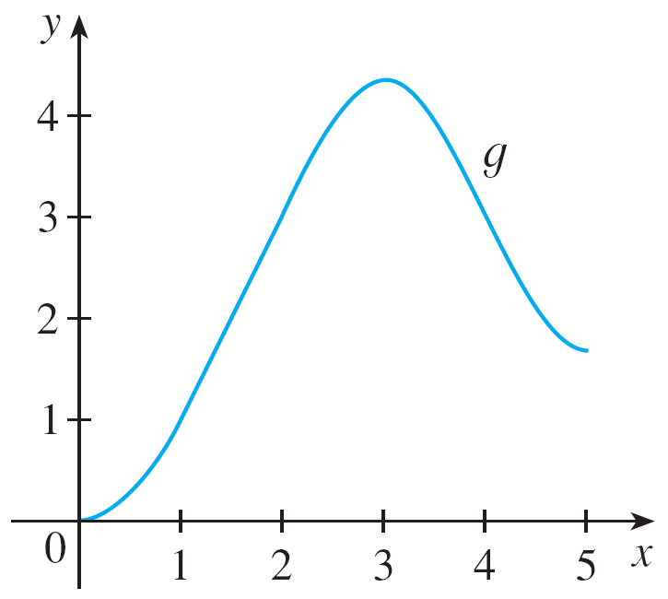
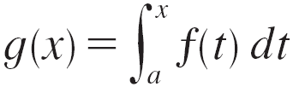
Example 1 – Solution
cont’d
We use these values to sketch the graph of g in Figure 4.
Figure 4

Slide 13
Example 1 – Solution
cont’d
Notice that, because f (t) is positive for t < 3, we keep adding area for t < 3 and so g is increasing up to x = 3, where it attains a maximum value.
For x > 3, g decreases because f (t) is negative.

Slide 14
Example 2
If , where a = 1 and f(t) = t², find a formula for and calculate g’(x).
SOLUTION
In this case, we can compute g(x) explicitly using the Evaluation Theorem:
Then

Slide 15


The Fundamental Theorem of Calculus
If g is defined as the integral of f by Equation 1, then g turns out to be an antiderivative of f. Hence g’ = f.
To see why this might be generally true, we consider any continuous function f with
Then can be interpreted as the area under the graph of f from a to x, as in Figure 1.
Figure 1

Slide 16
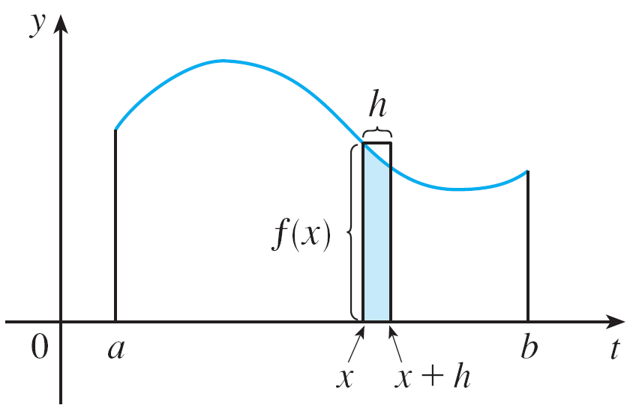
The Fundamental Theorem of Calculus
In order to compute g ′(x) from the definition of derivative we first observe that, for h > 0, g(x + h) – g(x) is obtained by subtracting areas, so it is the area under the graph of f from x to x + h (the shaded area in Figure 5).
Figure 5

Slide 17
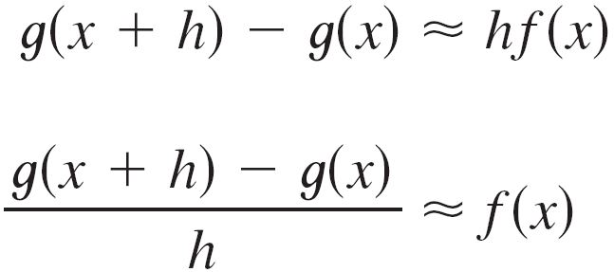
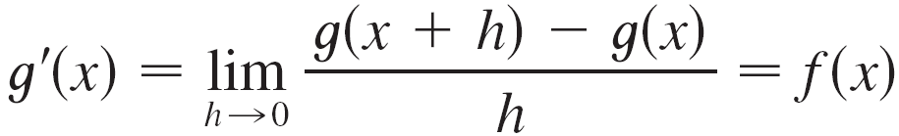
The Fundamental Theorem of Calculus
For small h you can see from the figure that this area is approximately equal to the area of the rectangle with height f (x) and width h:
so
Intuitively, we therefore expect that

Slide 18
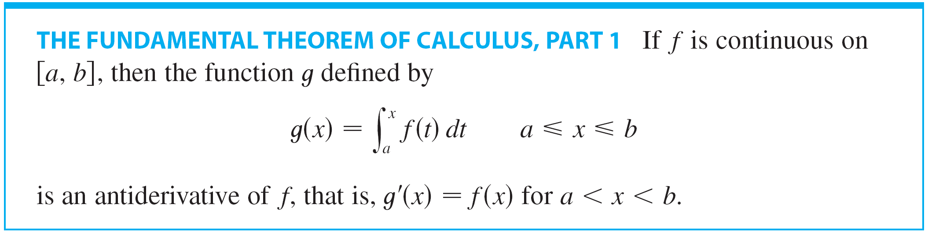
The Fundamental Theorem of Calculus
The fact that this is true, even when f is not necessarily positive, is the first part of the Fundamental Theorem of Calculus.

Slide 19
FTC1
In words, the FTC1 says that the derivative of a definite integral with respect to its upper limit is the integrand evaluated at the upper limit.

Slide 20
FTC1 PROOF
If x and x + h are in (a, b), then
So, for h ≠ 0,

Slide 21
FTC1 PROOF
For now, let us assume that h > 0.
Since f is continuous on [x, x + h], the Extreme Value Theorem says that there are numbers u and v in [x, x + h] such that f(u) = m and f(v) = M.
m and M are the absolute minimum and maximum values of f on [x, x + h].

Slide 22
FTC1 PROOF
By Property 8 of integrals, we have:
That is,
Since h > 0, we can divide this inequality by h:

Slide 23
FTC1 PROOF
Now, we use Equation 2 to replace the middle part of this inequality:
Inequality 3 can be proved in a similar manner for the case h < 0.

Slide 24
FTC1 PROOF
Now, we let h → 0.
Then, u → x and v → x, since u and v lie between x and x + h.
Therefore, and because f is continuous at x.

Slide 25
FTC1 PROOF
From Equation 3 and the Squeeze Theorem, we conclude that:
If x = a or b, then Equation 4 can be interpreted as a one-sided limit.
Then, Theorem 4 in Section 2.8 (modified for one-sided limits) shows that g is continuous on [a, b].

Slide 26
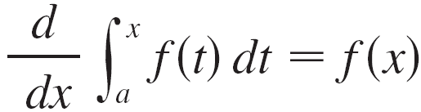
The Fundamental Theorem of Calculus
Using Leibniz notation for derivatives, we can write FTC1 as
when f is continuous.
Roughly speaking, this equation says that if we first integrate f and then differentiate the result, we get back to the original function f.

Slide 27
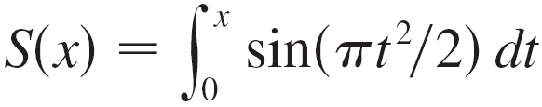
The Fundamental Theorem of Calculus
Although a formula of the form may seem like a strange way of defining a function, books on physics, chemistry, and statistics are full of such functions. For instance, the Fresnel function
Is named after the French physicist Augustin Fresnel, who is famous for his work in optics. This function first appeared in Fresnel’s theory of the diffraction of light waves, but more recently it has been applied to the design of highways.

Slide 28
Example 3
Find the derivative of the function
SOLUTION
As is continuous, the FTC1 gives:

Slide 29
Example 4
A formula of the form may seem like a strange way of defining a function.
However, books on physics, chemistry, and statistics are full of such functions.

Slide 30
Example 4
For instance, the Fresnel function
It is named after the French physicist Augustin Fresnel (1788–1827), famous for his works in optics.
It first appeared in Fresnel’s theory of the diffraction of light waves.
More recently, it has been applied to the design of highways.

Slide 31
Example 4
The FTC1 tells us how to differentiate the Fresnel function: S’(x) = sin(πx²/2)
This means that we can apply all the methods of differential calculus to analyze S.

Slide 32
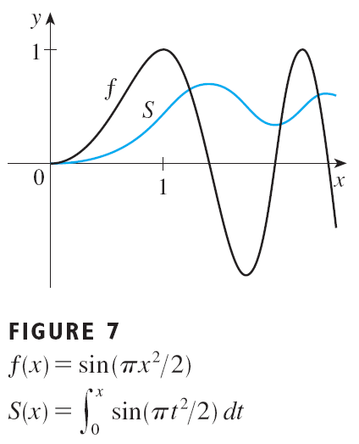
Example 4
Figure 7 shows the graphs of f(x) = sin(πx²/2) and the Fresnel function
A computer was used to graph S by computing the value of this integral for many values of x.

Slide 33
Example 4
It does indeed look as if S(x) is the area under the graph of f from 0 to x (until x ≈ 1.4, when S(x) becomes a difference of areas).

Slide 34
Example 4
Figure 8 shows a larger part of the graph of S.

Slide 35
Example 4
If we now start with the graph of S here and think about what its derivative should look like, it seems reasonable that S’(x) = f(x).
For instance, S is increasing when f(x) > 0 and decreasing when f(x) < 0.
So, this gives a visual confirmation of the FTC1.

Slide 36
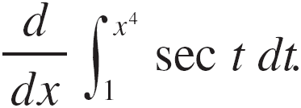
Example 5
Find

Slide 37

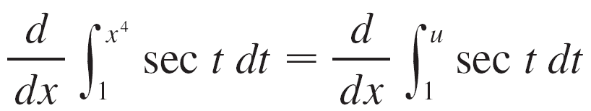
Example 5
SOLUTION:
Here we have to be careful to use the Chain Rule in conjunction with Part 1 of the Fundamental Theorem.
Let Then

Slide 38
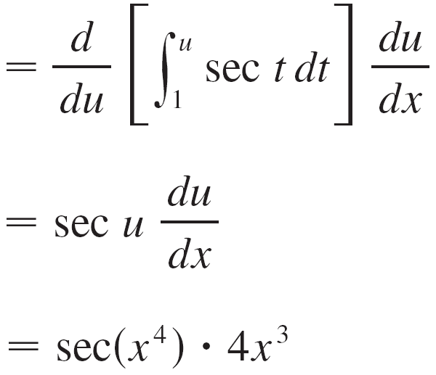


Example 5 – Solution
cont’d

Slide 39
Differentiation and Integration as Inverse Processes

Slide 40
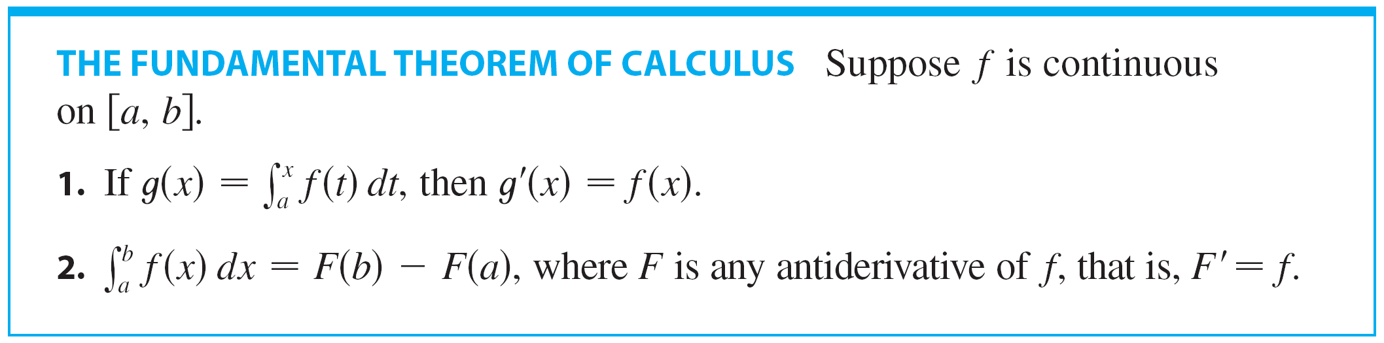
Differentiation and Integration as Inverse Processes
We now bring together the two parts of the Fundamental Theorem. We regard Part 1 as fundamental because it relates integration and differentiation.
But the Evaluation Theorem also relates integrals and derivatives, so we rename it as Part 2 of the Fundamental Theorem.

Slide 41


Differentiation and Integration as Inverse Processes
We noted that Part 1 can be written as
which says that if f is integrated and the result is differentiated, we arrive back at the original function f. In Section 4.3 we reformulated Part 2 as the Net Change Theorem:

Slide 42
Differentiation and Integration as Inverse Processes
This version says that if we take a function F, first differentiate it, and then integrate the result, we arrive back at the original function F, but in the form F(b) – F(a).
Taken together, the two parts of the Fundamental Theorem of Calculus say that differentiation and integration are inverse processes. Each undoes what the other does.

Slide 43
SUMMARY
The FTC is unquestionably the most important theorem in calculus.
Indeed, it ranks as one of the great accomplishments of the human mind.
Before it was discovered—from the time of Eudoxus and Archimedes to that of Galileo and Fermat—problems of finding areas, volumes, and lengths of curves were so difficult that only a genius could meet the challenge.

Slide 44
SUMMARY
Now, armed with the systematic method that Newton and Leibniz fashioned out of the theorem, we will see in the chapters to come that these challenging problems are accessible to all of us.

Slide 45
Average Value of a Function

Slide 46
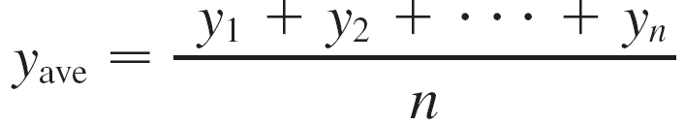
Average Value of a Function
It’s easy to calculate the average value of finitely many numbers y₁, y₂, . . . , y_{n}:
But how do we compute the average temperature during a day if infinitely many temperature readings are possible?

Slide 47
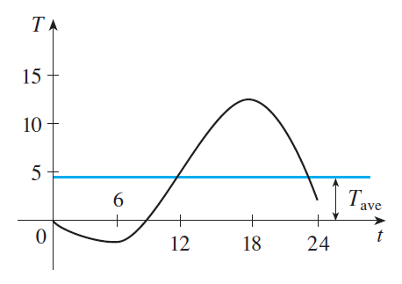
Average Value of a Function
Figure 9 shows the graph of a temperature function T(t), where t is measured in hours and T in °C, and a guess at the average temperature, T_{ave}.
Figure 9

Slide 48


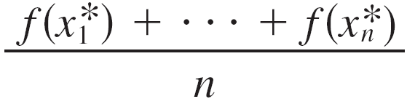
Average Value of a Function
In general, let’s try to compute the average value of a function y= f(x), a ≤ x ≤ b.
We start by dividing the interval [a, b] into n equal subintervals, each with length ∆x = (b – a) / n.
Then we choose points in successive subintervals and calculate the average of the numbers

Slide 49


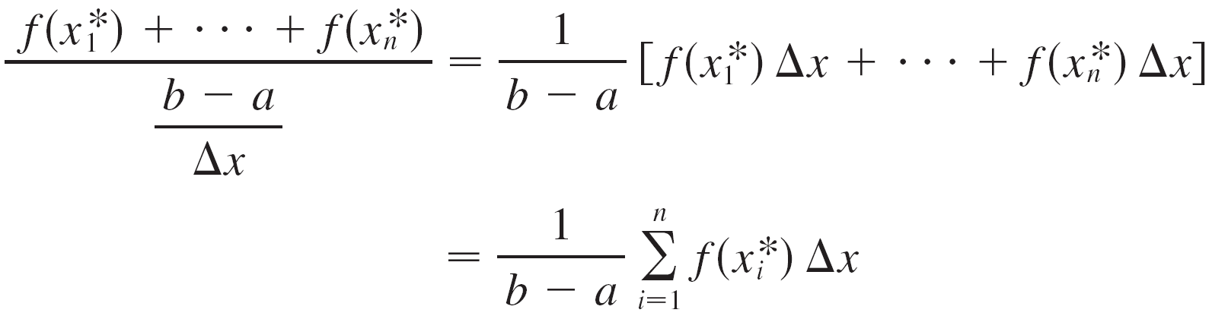
Average Value of a Function
Since we can write and the average value becomes

Slide 50
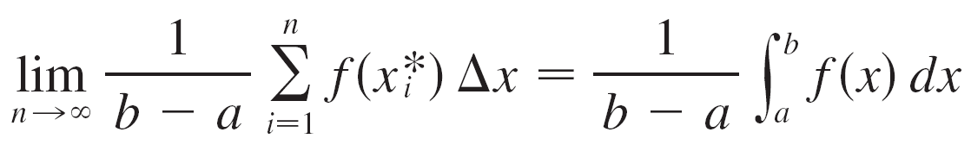
Average Value of a Function
If we let n increase, we would be computing the average value of a large number of closely spaced values.
The limiting value is
by the definition of a definite integral.

Slide 51
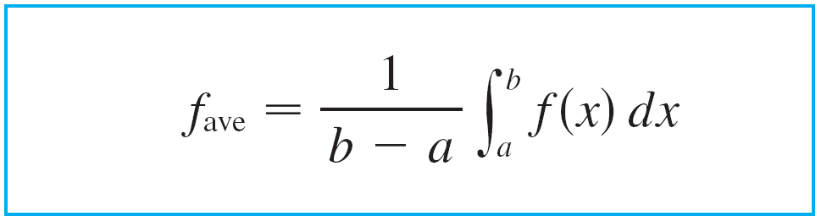
Average Value of a Function
Therefore, we define the average value of f on the interval [a, b] as

Slide 52

Example 6
Find the average value of the function on the interval [–1, 2].

Slide 53
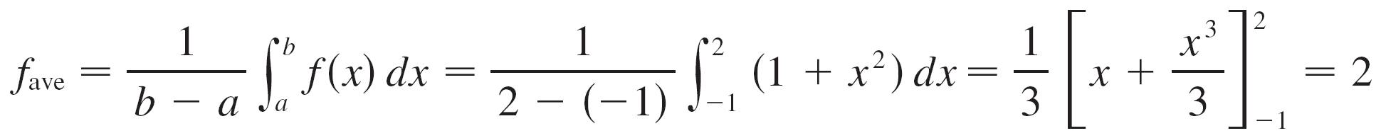
Example 6
SOLUTION:
With a = –1 and b = 2 we have

Slide 54
Average Value of a Function
If T(t) is the temperature at time t, we might wonder if there is a specific time when the temperature is the same as the average temperature. For the temperature function graphed in Figure 9, we see that there are two such times—just before noon and just before midnight.
Figure 9

Slide 55
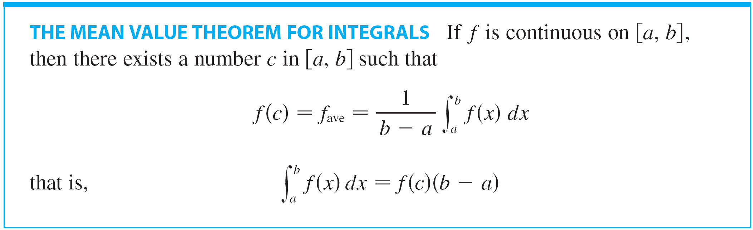
Average Value of a Function
In general, is there a number c at which the value of a function f is exactly equal to the average value of the function, that is, f(c) = f_{ave}?
The following theorem says that this is true for continuous functions.

Slide 56
THE MEAN VALUE THEOREM FOR INTEGRALS PROOF
Let for a ≤ x ≤ b.
By the Mean Value Theorem for derivatives, there is a number c between a and b such that
But by FTC1. Therefore

Slide 57
THE MEAN VALUE THEOREM FOR INTEGRALS
The geometric interpretation of the Mean Value Theorem for Integrals is that, for positive functions f, there is a number such that the rectangle with base [a, b] and height f(c) has the same area as the region under the graph f of from a to b.

Slide 58
See Figure 10 and the more picturesque interpretation in the margin note.

Slide 59
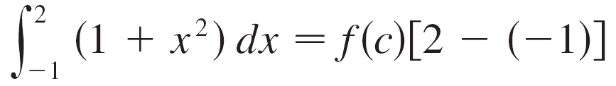


Example 7
Since is continuous on the interval [–1, 2], the Mean Value Theorem for Integrals says there is a number c in [–1, 2] such that
In this particular case we can find c explicitly.
From Example 6 we know that so the value of c satisfies

Slide 60


Example 7
cont’d
Therefore so
Thus in this case there happen to be two numbers c = ±1 in the interval [–1, 2] that work in the Mean Value Theorem for Integrals.

Slide 61
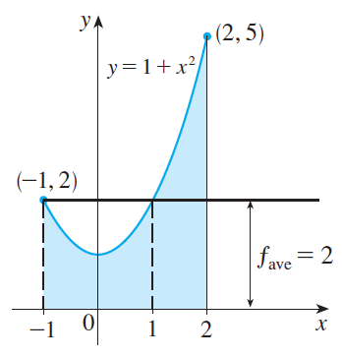
Example 7
cont’d
Examples 6 and 7 are illustrated by Figure 11.
Figure 11

